Slide 1
Employee Data Analysis using Excel
STUDENT NAME: P.SUNITHA
REGISTER NO:312201687
DEPARTMENT: COMMERCE
COLLEGE: PROF.DHANAPALAN COLLEGE OF SCIENCE AND MANAGEMENT

Slide 2
PROJECT TITLE
Employee Performance Rating Analysis using Excel

Slide 3


AGENDA
Problem Statement
Project Overview
End Users
Our Solution and Proposition
Dataset Description
Modelling Approach
Results and Discussion
Conclusion
3/21/2024 Annual Review

Slide 4

PROBLEM STATEMENT
Who: How the problem affects others
What: Explain the problem
Where: The location where the problem occurs
When: Timing of the problem
Why it occurs: Importance of the problem

Slide 5

PROJECT OVERVIEW
To review the 20 members of employee performance regarding PERFORMANCE RATING
Apply and reinforce your knowledge through practical exercises
Allow yourself sufficient time to experiment with diverse problem-solving approaches.
Seek valuable insights from others to refine your problem-solving abilities
Utilize proven problem-solving tools that have stood the test of time

Slide 6
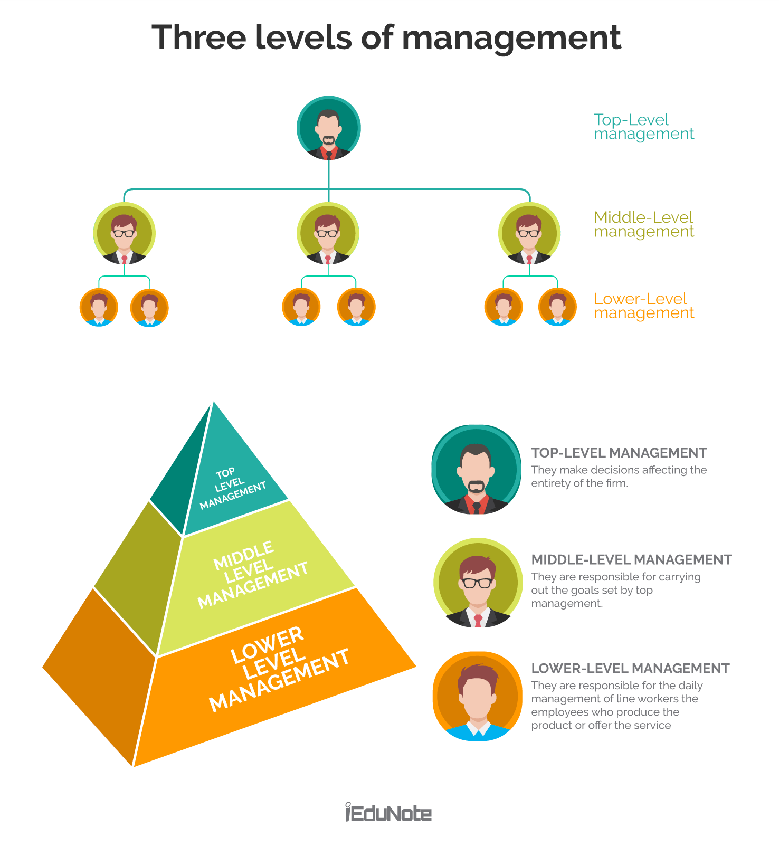

WHO ARE THE END USERS?
An end user is a person who uses a product or service, and is often the customer who buys it from a company.
However, end users and customers are not always the same.
In computing, an end user is a person or software that uses an information system. For example, when using a computer program, the end user is the person who needs to understand how to use the program to accomplish a task or goal. They also need to be able to provide feedback on their experience

Slide 7

OUR SOLUTION AND ITS VALUE PROPOSITION
Conditional formatting –missing
filter remove
formula -performance
pivot -summary
graph –data visualization

Slide 8
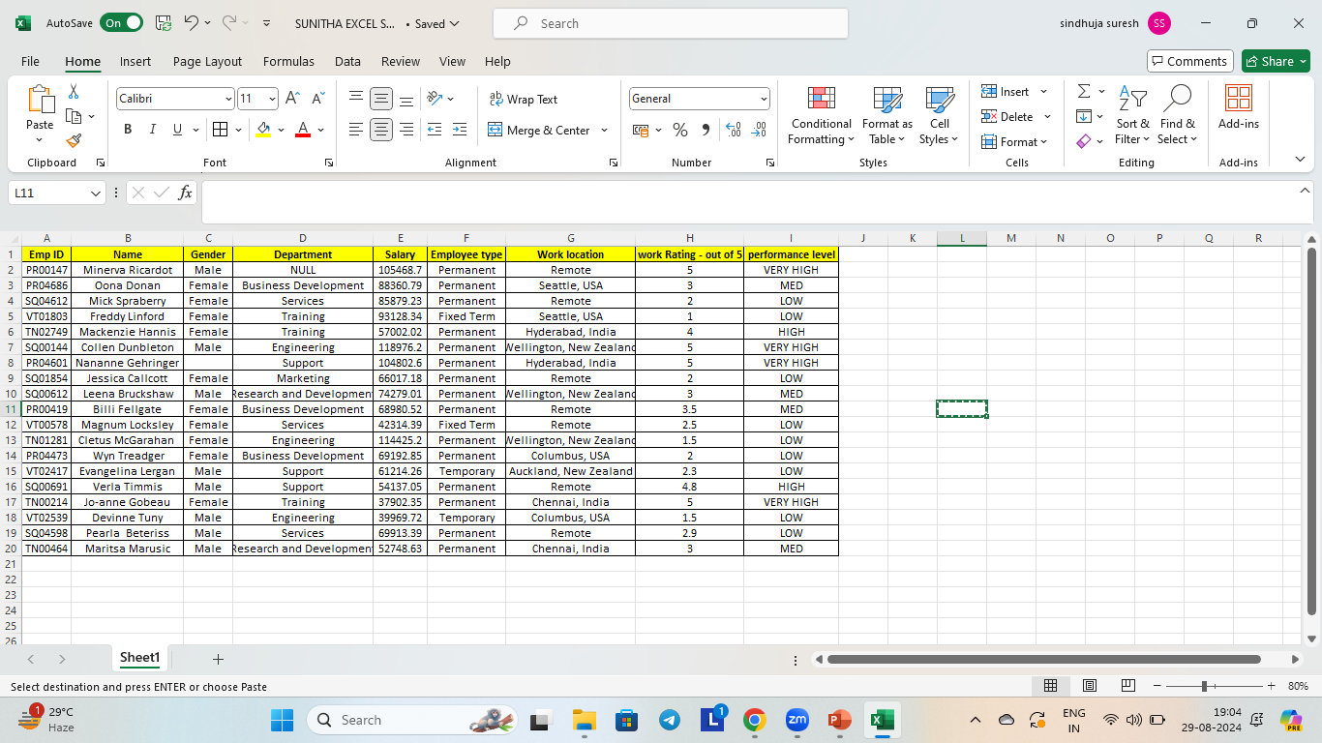
Dataset Description
EMPLOYEMENT DETAILS
TOTAL 20 MEMBERS
9 Features
Employement ID
Name
Gender
Department
Salary
Employee type
Work location
Work rating
Performance level

Slide 9

THE "WOW" IN OUR SOLUTION
PERFORMANCE LEVEL =IFS(J2>=5,”VERY HIGH”,J2>=4,”HIGH”,J2>=3,”MED”,TRUE,”LOW”)
3/21/2024 Annual Review
9

Slide 10
MODELLING
Data collection → Feature collection→Data anaylsis→Employee Performance level→ Performance Rating→Process the data and final the result
Collect data and observe
Give context
Clearly outline the problem
State the financial costs of the problem
Back up your findings
Provide a possible solution
State the advantages of the solution proposed
Close by summing up the problem and the solution
Stay curious
10

Slide 11
RESULTS
.
11

Slide 12
conclusion
Gather data and observe
Frame the problem properly
Keep asking and check in on the progress)
Growth mindset
covered the root cause of the problem will help you avoid ineffective band-aid solutions.

